Slide 1

SAP FICO

Slide 2
Topics
Financial Accounting
  General Ledger
  Accounts Receivables
  Accounts Payables
  House Bank
  Asset Accounting

Slide 3
Financial Accounting
The main configuration or customization needs to handle for following areas –
- Fiscal year
- Posting period
- Chart of Accounts
- Retained Earning A/c

Slide 4
Accounts
Payables
(Materials
Management)
Accounts
Receivables
(Sales & Distr.)
General Ledger
Bank
Fixed Assets

Slide 5
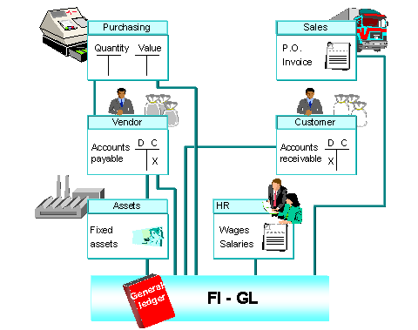

Slide 6
General Ledger
Being the main ledger all sub-ledger balances are always gets updated in the general ledger in real time.
The balances from this ledger are shown in the financial statements.
The control accounts from general ledger gets link to all sub-ledger accounts (i.e. Reconciliation accounts)

Slide 7
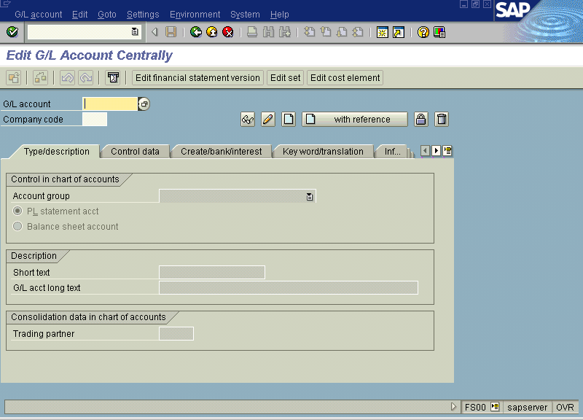

Slide 8
Accounts Receivables
(Customer accounting)
All records of customer (master and transactions) are handled independently in AR module.
Though the AR works independently these transactions are updated in the general ledger automatically at the same time.
Separate reports are available to access customer details such as -
- Customer analysis
- Aging report (due date analysis)
Individual customer balances
contn…

Slide 9
Accounts Receivables
(Customer accounting)
Generally all the basic entries will be entered in the Sales and Distribution module and then subsequently will be passed to FI automatically. So the documents from SD module are called as reference (base) documents.

Slide 10
Transactions
Customer Invoice
It is also called as ‘Outgoing Invoice’. Actually this invoice is generated in the SD module and then passed (Release) on to the FI.
After invoice, all activities (e.g. payment, dunning, interest charging, correspondence) are taken care by FI.
In AR [FI] it is also possible to enter invoice directly which will be without referencing to any previous documents (like sales order or delivery).

Slide 11
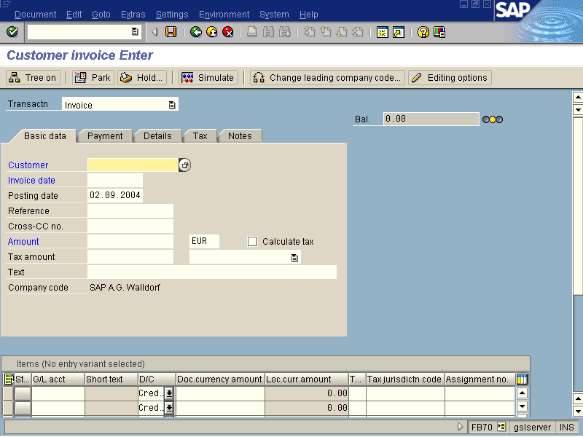

Slide 12
Payment can be handled in many ways –
- Full payment (Invoice will be cleared)
- Part payment (Inv. will not be cleared
until rest amount is received)
- Cash discount (Updates Discount a/c)
- Residual payment (Clears invoice and
creates open item for rest
balance)
- Down payment (Payment is received
prior to sending invoice)

Slide 13
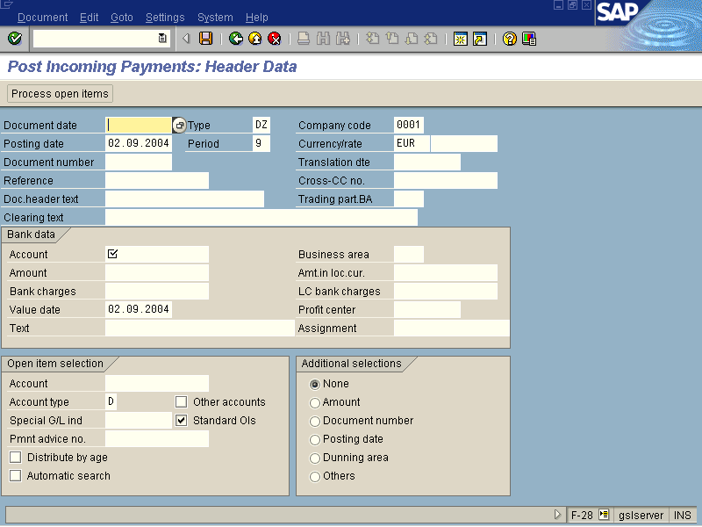

Slide 14
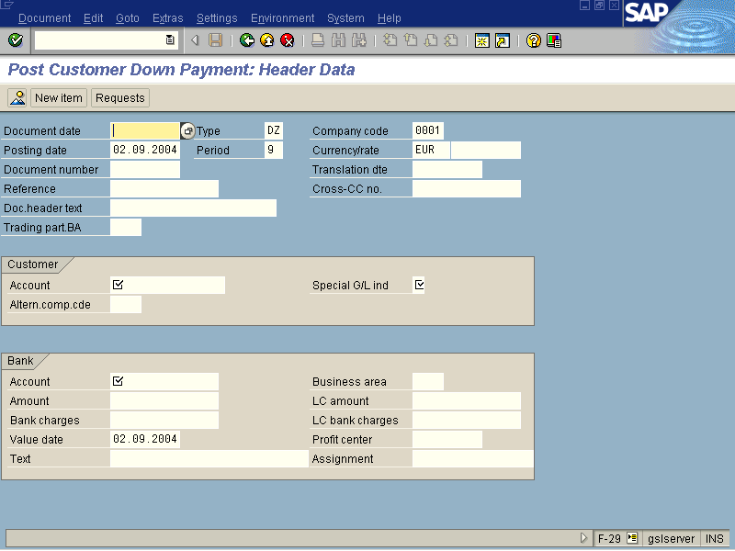

Slide 15
Accounts Payables
(Vendor Accounting)
The functionality of AP module is exactly opposite to the AR.
All records of vendor (master and transactions) are handled independently in AP module.
Though the AP works independently these transactions are updated in the general ledger automatically at the same time.
Separate reports are available to access customer details such as -
- Vendor analysis
- Individual vendor balances
contn…

Slide 16
Accounts Payables
(Vendor Accounting)
Generally all the basic entries will be entered in the Materials Management module and then subsequently will be passed to FI automatically. So the documents from MM module are called as reference (base) documents.
The major area handled by MM module is stock (quantity and value) updating which is NOT by AP.

Slide 17
In short, these AR and AP sub-ledgers are called as an extension to SD and MM modules.
The receipts and payments are taken care by AR and AP. So these entries by means of Bank which is another sub-ledger, reaches to general ledger. Simultaneously customer and vendor accounts will be cleared from outstanding list.

Slide 18
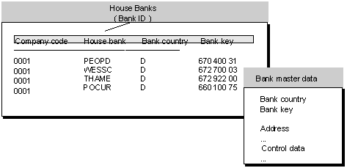
Banks

Slide 19
Banks
This sub-ledger also called as House bank (bank details of your company) .
This sub-ledger allows you to maintain detail information of your companies bank account and transactions passed with the same.
This sub-ledger has following features –
- Payment methods
- Check printing
- Amount limits (maximum and minimum)
- Bank statements (Reconciliation statement)

Slide 20
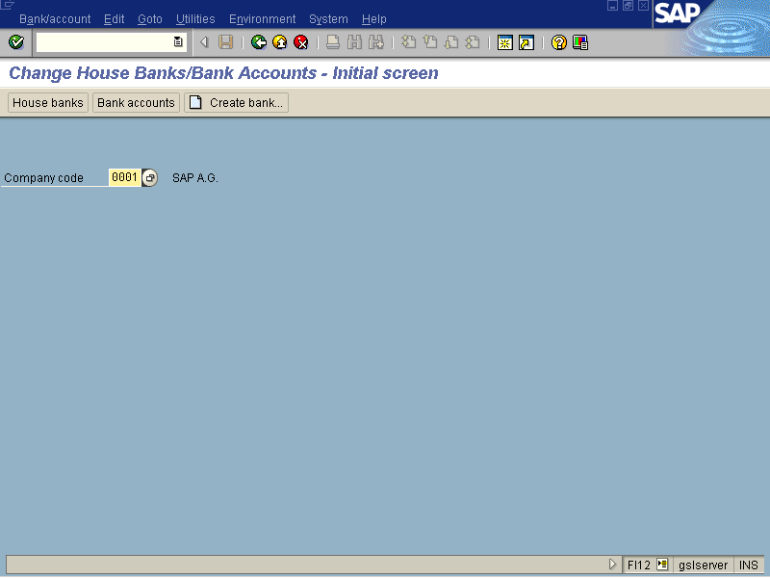

Slide 21
Automatic payment program
Instead of using manual payment method to pay for more than one invoice in single activity, you can use ‘Automatic payment program’ after configuration.
You need to configure –
- Your company details
- Minimum amount to be paid/received
- Foreign currency dealings allowed or not?
- Payment methods (printing program)
- GL accounts, ranking order and so on…

Slide 22
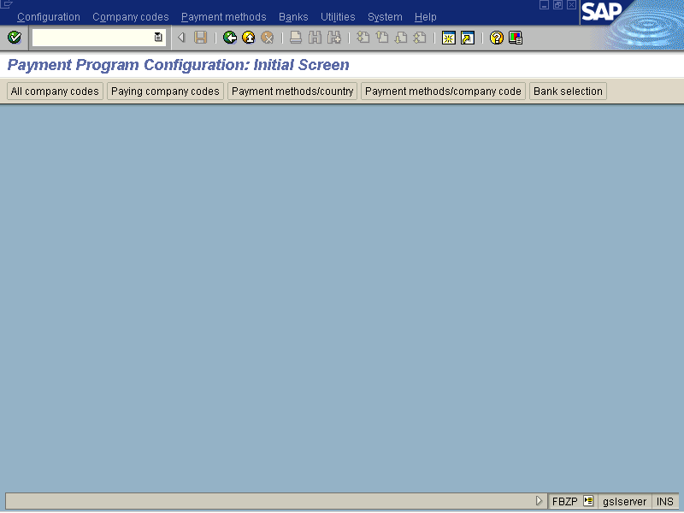

Slide 23
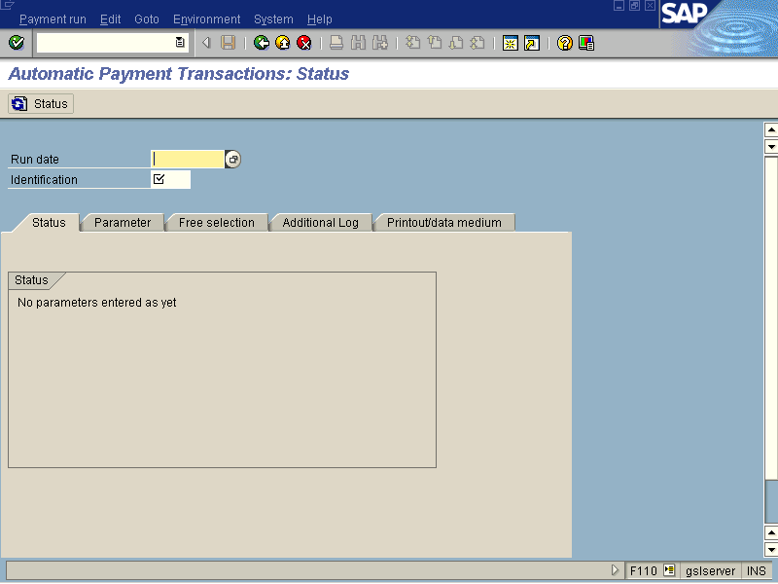

Slide 24
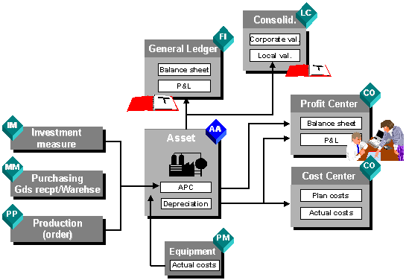
Asset Accounting

Slide 25
Asset Accounting
This sub-ledger allows you to maintain all fixed assets.
The asset values including cost of asset, depreciation value and retirement (sale value) of asset are maintained in detail in the Asset chart (Register).
The asset’s life, depreciation rates, depreciation methods are handled very neatly in the system.

Slide 26
Asset Accounting
Various reports are available to view asset values –
- Asset explorer
- Asset account balances
- Asset history sheet
- Depreciation reports (According to
Company Act and Income Tax Act)

Slide 27
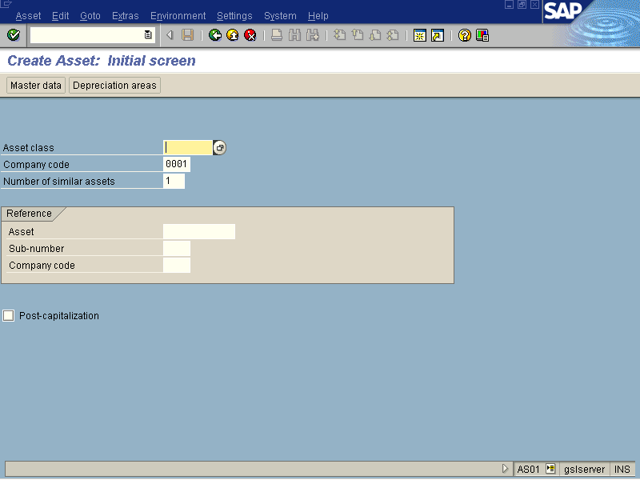

Slide 28
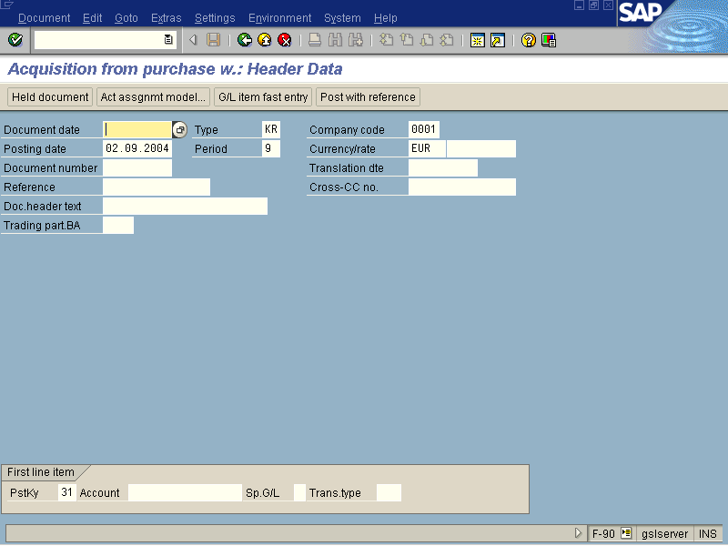

Slide 29
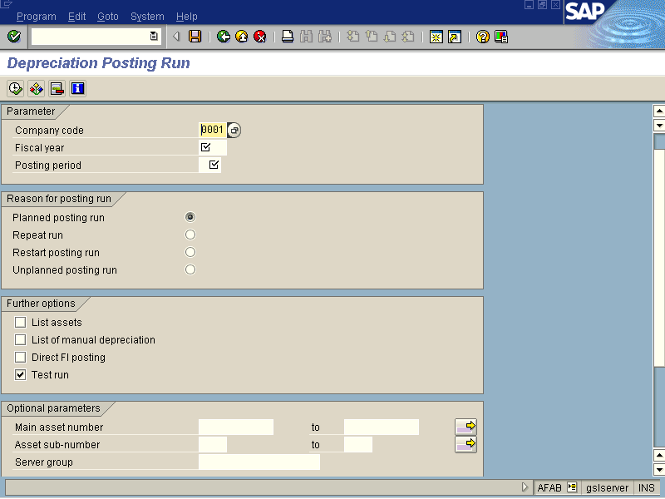

Slide 30


Slide 31
